Slide 1
While Loops
For Junior Knights
By Rachael Sera

Slide 2
If Review
If-statements evaluate a “Boolean” condition
Boolean condition – evaluates to True or False
If the condition is true, the code inside the if-statement will execute
Use indentation to indicate what code is controlled by the if-statement
So far our code executes top to bottom and never goes back up
Loops let us go back up and repeat code

Slide 3
While Loop
Like if-statements, Loops have a Boolean condition
If-statements execute the code exactly once if the condition is true; while-loops execute the code as long as (“while”) the condition is true
Thus, if we don’t want the code inside to execute indefinitely, we need to change the value of the variable that’s evaluated in the Boolean condition inside the loop
Like with if-statements, use a colon at the end of the condition and use indentation to show what code is included in the loop

Slide 4
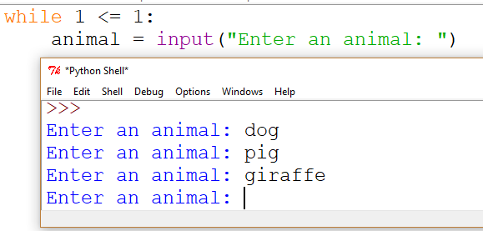
While loop
The prompt to enter an animal will continue indefinitely because 1 <= 1 is always true
Use a variable so the condition can be changed
Notes:
Add count=1. Then increment count.

Slide 5
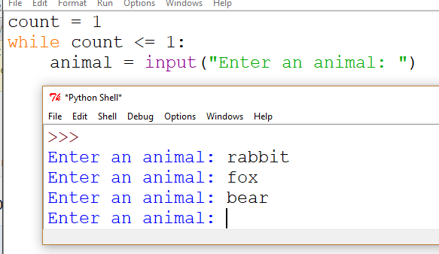
While Loop
This is essentially the same code as before, but with a variable instead

Slide 6
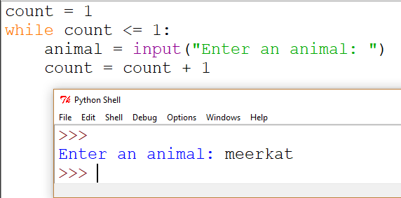
While loop
Increment the variable “count” in the loop
Now when it loops again, count is 2, which is not <=1, so the loop does not execute a 2nd time.

Slide 7
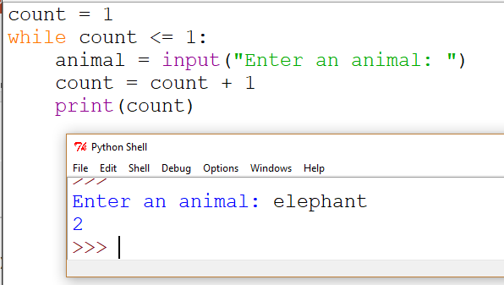
Trace the Program
Count is initialized to 1
The while-loop checks the condition to see if count is <= 1
The condition is true, so the code inside the while loop will be executed
The user is asked for an animal
“count” is incremented by 1, so “count” is now equal to 2
The value stored in “count” is printed
The while loop checks the condition again. The condition is false (2 is not <= 1), so the code inside the while-loop is not executed
The program ends
Notes:
Change the condition to <= 3 and see what happens.

Slide 8
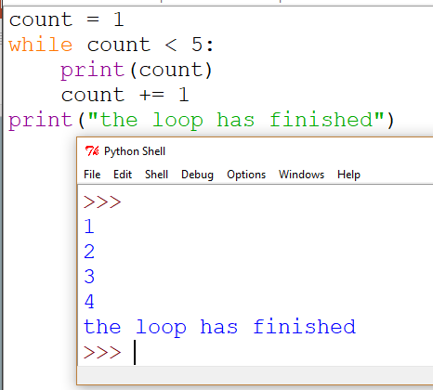
While Syntax
Note the Boolean condition and the incrementation of the variable. Those are key elements of a While Loop.
If we don’t increment “count,” then the loop would run forever (it would also run forever if we write “while True:” because it’s always true).
Notice how the value of “count” changes with each iteration of the loop.
count += 1 is shorthand for count = count + 1
Notes:
Trace this code. On the last iteration, count is 5, so the condition is false and the loop is not entered (which is why it doesn’t print 5)

Slide 9
Loop Flowchart
False
True
count < 5 ?
print(count)
while count < 5:
print(count)
count += 1
print(“The loop has finished)
count+=1
print()

Slide 10
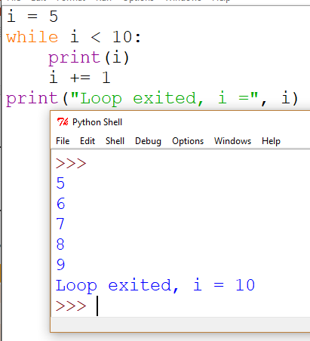
How is i changing
Values of i
Code
i | i < 10? | Enter loop?
5 | Yes | Yes
6 | Yes | Yes
7 | Yes | Yes
8 | Yes | Yes
9 | Yes | Yes
10 | No | No

Slide 11
Example Problems!
Write a program to print out all the numbers from 1 through a number that the user entered

Slide 12
Example Problems!
Write a program that asks the user for a number and then prints the sum of all numbers from 1 to that number. For example, if the number is 4, then you calculate 1+ 2+ 3+ 4 = 10.
Sample IO
Enter the endpoint
5
The sum from 1 through 5 is 15
(code solution on next page)

Slide 13
Count | sum
1 | 1
2 | 3
3 | 6
4 | 10
5 | 15

Slide 14
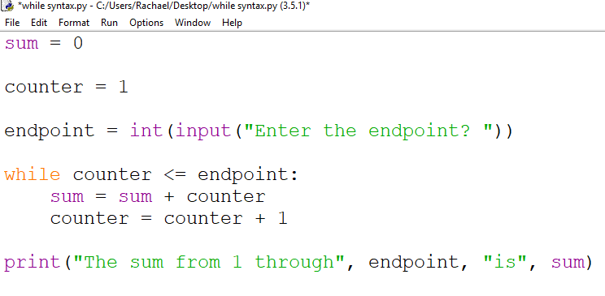
Notes:
Talk about debugging

Slide 15
Example Problems!
Write a program that prints out stars (*). Have the user enter how many stars wide and tall you should print.
Example:
Width = 6, height = 4 will print out:
******
******
******
******

Slide 16
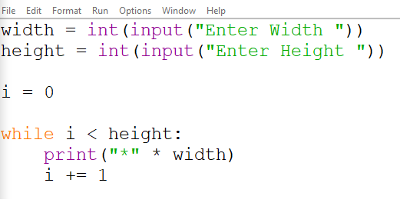

Slide 17
Non-counting loops
So far, the loops we’ve seen execute based on a count. They repeat until we’ve executed the loop a certain number of times.
While loops are particularly useful when you don’t know how many times you need to execute the loop
Loop until reaching a particular value (“sentinel”)
Loop until a final state is achieved (“flag”)

Slide 18
Sentinel Controlled Loop
A “sentinel” is a value that indicates the loop should end (often user input value)
In this way, the loop won’t iterate a predetermined number of times; instead it will end once the “sentinel” value is reached

Slide 19
Example: Sum user input
Write a program to add up numbers that the user enters. When the user is finished entering numbers, they will enter the number “0” to indicate they are done. Print out the sum of all the numbers the user entered.
In this problem, we don’t know how many numbers the user will enter, so we can’t use a counter variable and stop it at some predetermined endpoint.
We will use “0” as our “sentinel” value to denote the end of their input.

Slide 20
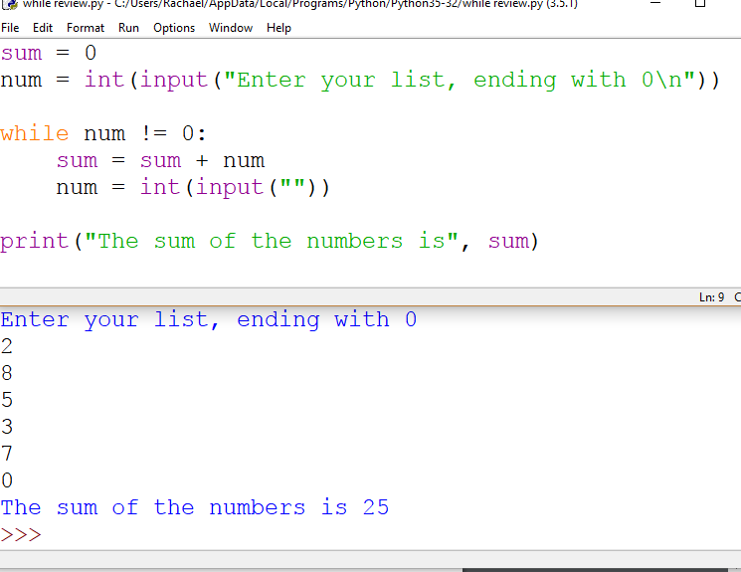

Slide 21
Flag Controlled Loop
If we write a loop as “while True:” or “while False:” it will either run forever, or never run, respectively.
If we use a variable that’s first set to True and then we change it to False when we’ve reached whatever condition should end the loop, we can run the loop as many times as necessary to reach that goal.
That’s the idea behind a “flag.” We’ll set the flag variable to True or False and change its value based on whether we’ve need to execute the loop or not.

Slide 22
Example: Snake eyes
Write a program to simulate rolling 2 6-sided dice and continue rolling until you get the sum on the dice to be 2.
In this problem, we don’t know how many rolls it will take to get the sum to be 2, so a while loop with a flag to indicate that we’ve reached our goal of 2 will work well

Slide 23
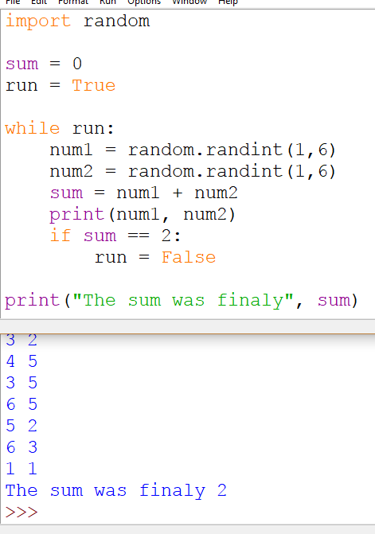

Slide 24
Hints for Problems
In the above examples, we changed our variable that controls the loop by one (e.g. count = count + 1)
However, you can change that variable by any amount, including subtracting from it.
Recall “modulus.” Mod is the remainder when you divide 2 numbers. If the number divide evenly, then the mod of the 2 numbers (remainder) is 0.

Slide 25
KEY POINTs
Syntax:
while <condition>:
statement1
statement2
Everything indented below the while is repeated every time we enter the loop (statement1 in the example above)
Once you indent back to the left, the code is outside the while; it’s what happens once the while condition is false (statement2 in the example above)
<condition> is a Boolean condition (evaluates to true or false)

Slide 26
Key Points
The format of <condition> is:
<value> <operator> <value>
Where “value” is a variable or expression that evaluates to a number
And where “operator” is one of the following:
==
!=
<
<=
>
>=

Slide 27
KEY POINTs
You must always change at least one of the values in the condition. Otherwise, the condition will either always be true (loop will run forever) or always be false (loop will never execute).

